Slide 1

AI-Based RAG system for VR Semiconductor Training
Vincent Chu

Slide 2
Problem Statement
Project Goals
Challenges
Gain knowledge of our project by:
Reading internal documents to gain knowledge
Process ANY type of document given
Be expandable with future documents and features
Scalable document uploading
Be able to be built with websocket, machine vision, etc
Continuous validation testing and self improvement
Create a chatbot inside our VR environment that does the following:
Answer questions accurately
Equipment specs, procedures, and protocols
Answer questions in a timely manner
Answer in sub 3 second times
Answer questions reliably
Run locally and achieve 24/7 uptime

Slide 3


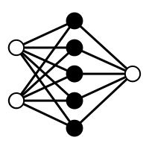
Previous Attempts
Direct openAI API Call
Local Ollama + RAG Server
Training an existing AI model
Would produce okay answers, but are generic responses.
Generic responses, with zero knowledge of internal lab resources
Would produce okay to decent answers, but not as accurate as we would like it
Network reliability issues hindered further development and improvement
Hardware bound to the university computer resources
Limited tunability
Extremely inaccurate answers with massive hallucination results
Did not have the resources to train, nore enough data

Slide 4
Methodology

Slide 5
What is RAG?
Definition
How?
Retrieval, Augmented, Generation
This gives an AI model a reference library before it answers a questions
Searches documents for RELEVANT information based on OUR data
Step 1: Ask a question
Step 2: Question is mathematically
converted into an embedding to capture meaning
Step 3: Searches the database for semantic similarity
Step 4: Combines the context found + question
Step 5: AI generates the answer

Slide 6
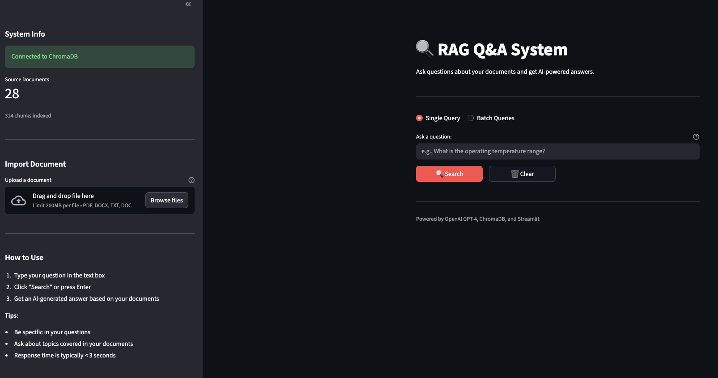
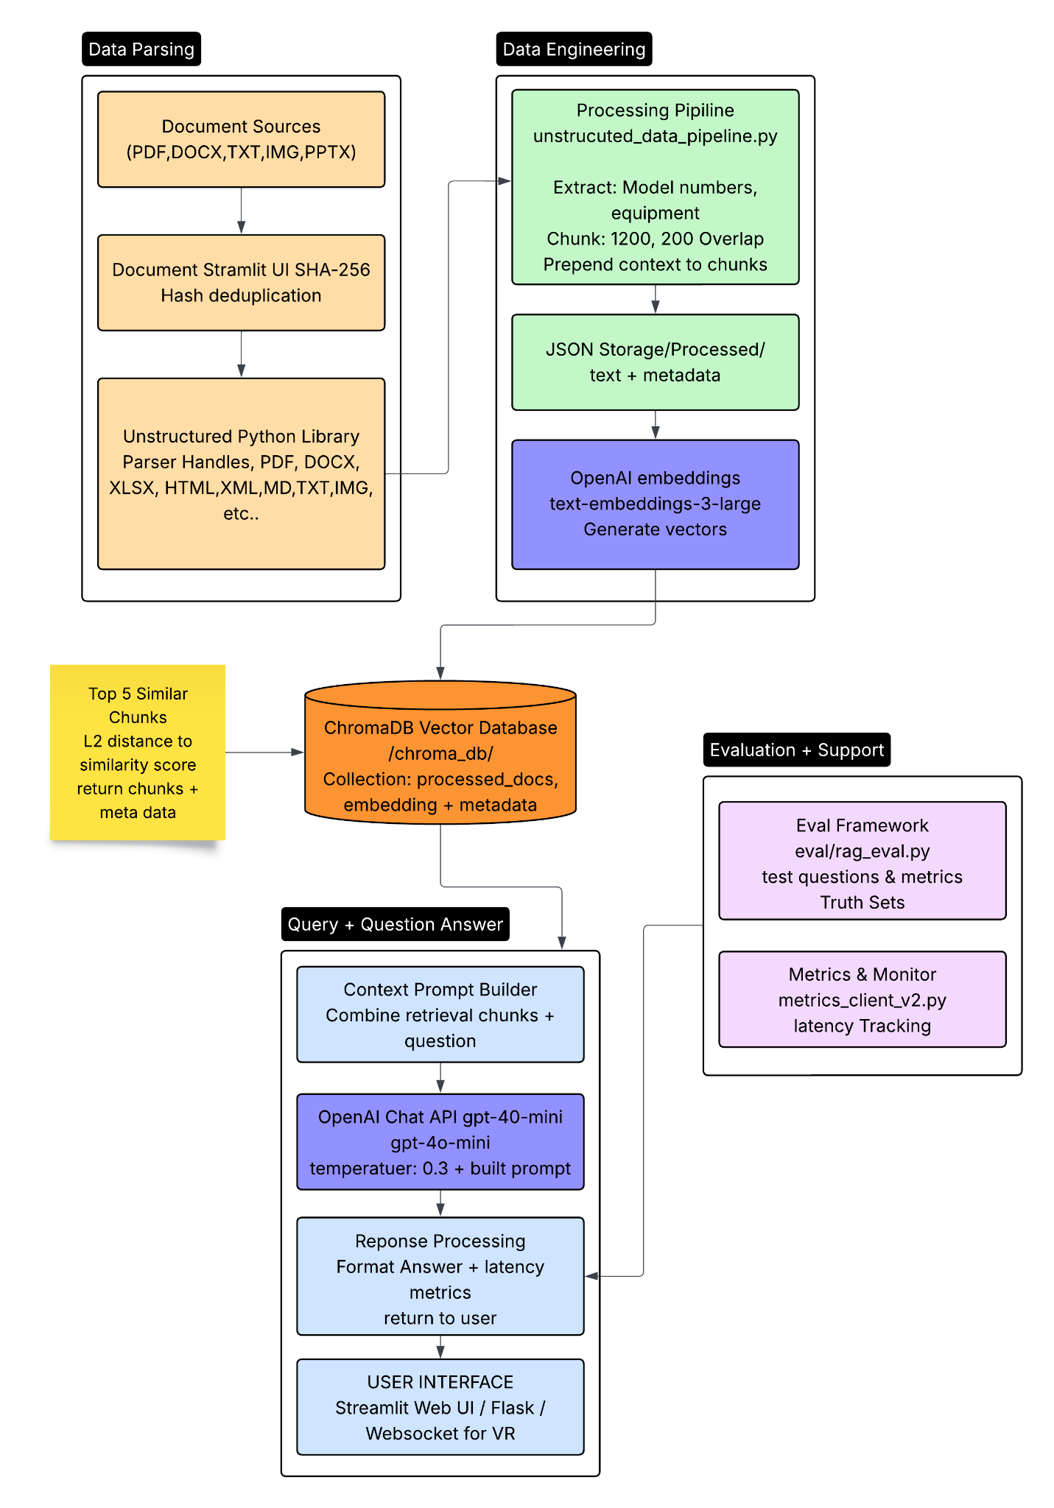
Solution Part 1 - Data Parsing

Slide 7
Solution Part 2 - Model Extraction
How it works
Step 1: Context extraction algorithm is used to grab model numbers
(?:Model\s+)?([A-Z]{2,}[-\s]?\d{2,}[A-Z0-9]*)
Step 2: The context is formatted and prepended to every chunk generated from that document
Model: MA6BA6 | Equipment: Mask Aligner
Step 3: After chunking, they are converted to JSONL format which works best for embedding models

Slide 8
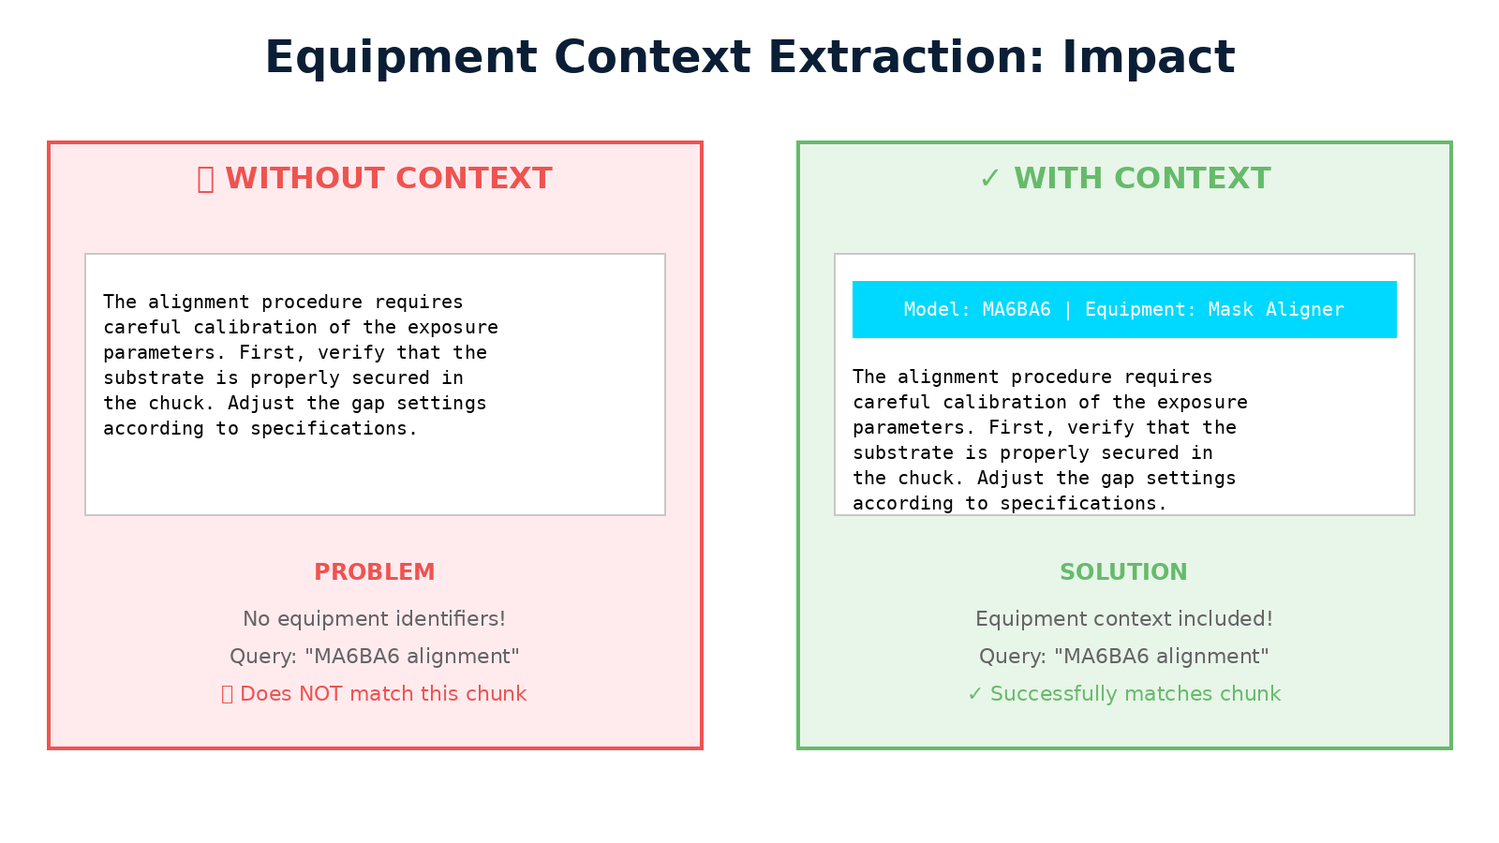

Slide 9
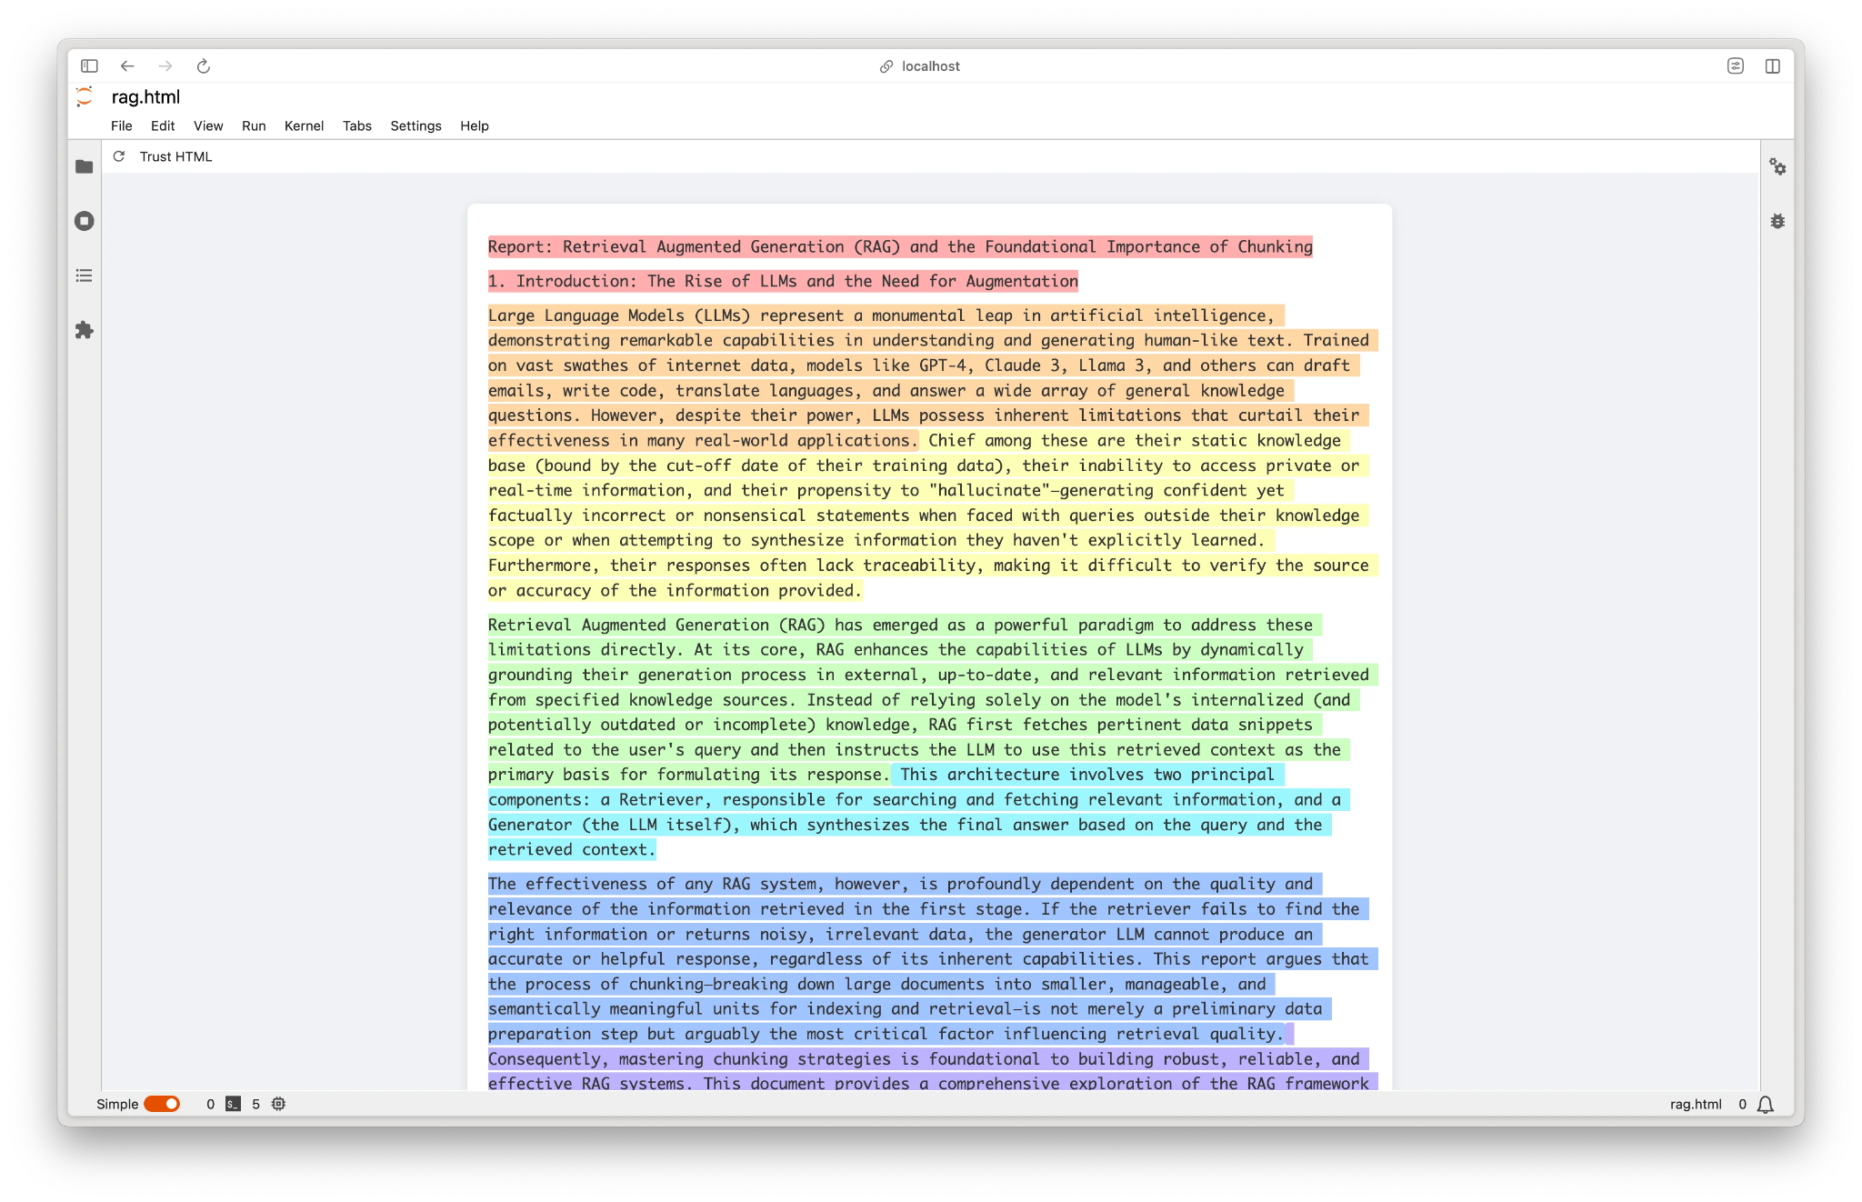
Solution Part 1 - Data Parsing and chunking
Why?
When documents are parsed, they are broken up into “chunks” to be manageable processing.
To add further accuracy, when model numbers are found, they are prepended to each chunk to expand context

Slide 10
Solution Part 3 - Data engineering
Sending to OpenAI Embedding Model
After chunking, our JSONL’s are being sent to OpenAI’s
text-embeddings-3-large model to generate our mathematical version of our documents, which are then saved into our ChromaDB database

Slide 11
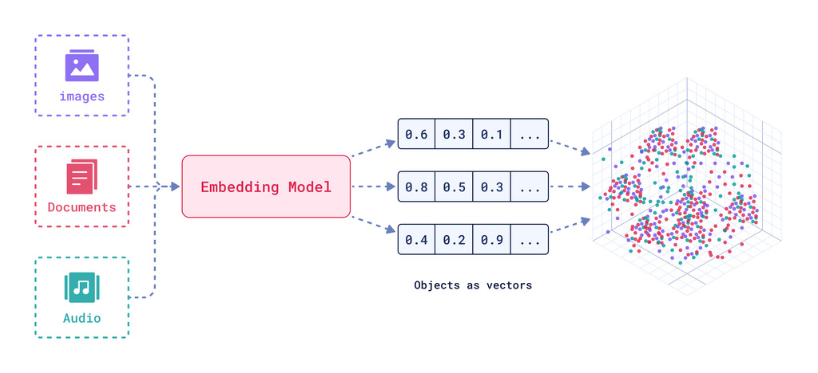
Solution Part 3 - An embedding visual example
https://qdrant.tech/articles/what-are-embeddings/

Slide 12
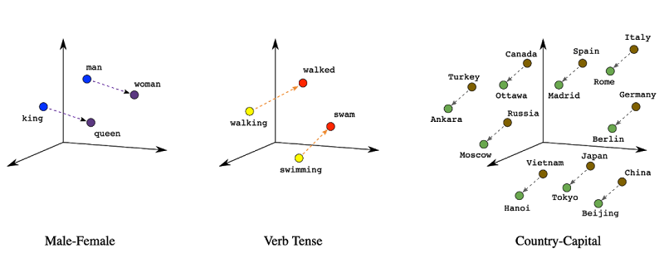
Solution Part 3 - An embedding visual example
L2 semantic = Euclidean Distance = straight line distance between two points
https://tonia.ai/dl-nlp.html

Slide 13
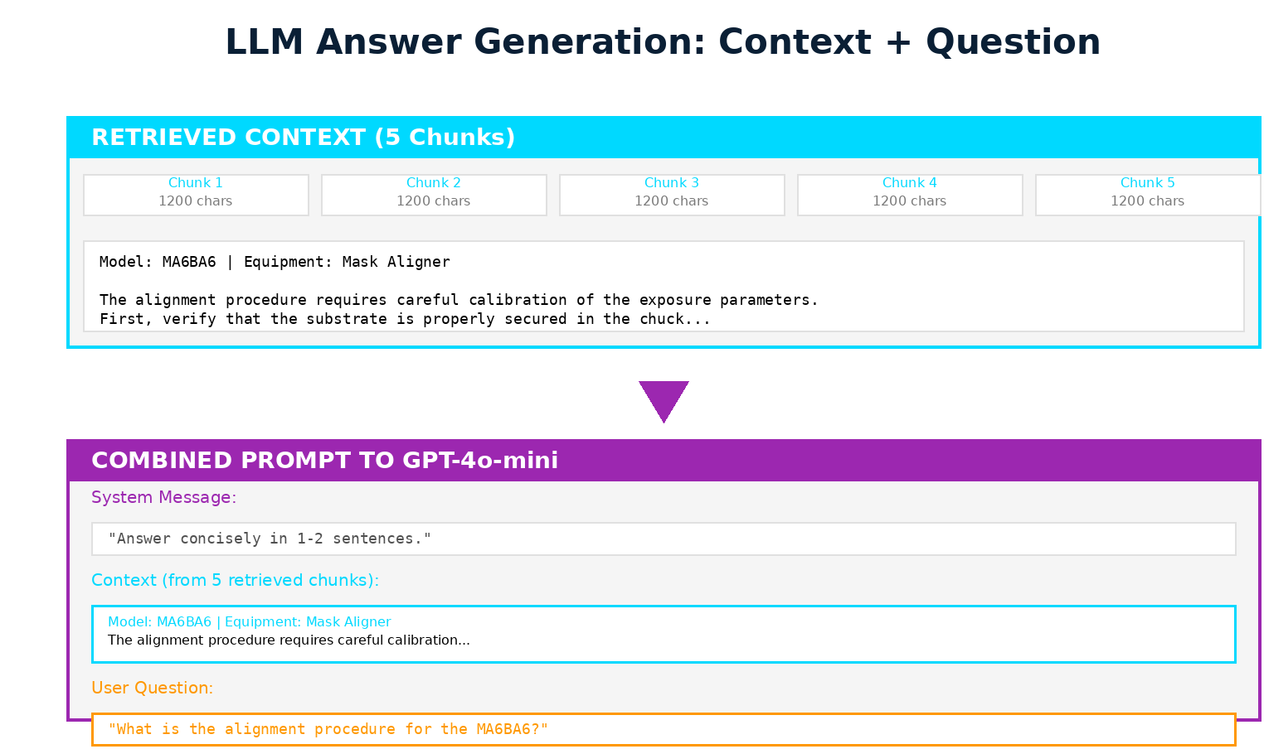
Solution Part 4 - Answer generation
How?
The context from embeddings and the question are combined and fed into GPT-4o-mini to generate a sentence

Slide 14
Methodology Overview

Slide 15
The Results Part 1
How - LLM answer generation
How - Retrieval Effectiveness
Mean Reciprocal Rank (MMR)
A test set of 25 ground truth question-answer pair was constructed to compare ground truth answers vs LLM generated answers
Answers are evaluated through an LLM comparing the truth and generated answer, scoring it from 1-5, with a 4+ score being correct
Recall@K measures the percentage of test queries where at least one relevant chunk appears within the top K search results
This accesses retrieval effectiveness for generation quality
This measures the quality of ranking. IE, “On average, how HIGH UP in the search result is the first relevant answer”
Position 1: [Chunk A] ← Most similar to query
Position 2: [Chunk B]
Position 3: [Chunk C]
Position 4: [Chunk D]
Position 5: [Chunk E] ← Least similar to query

Slide 16
The Results Part 1 Table
Metric | Result
Recall@5 | 92% - In 92 out of 100 queries, at least 1 relevant chunk appears in the top 5 results. The relevant information is found 92% of the time
Answer Correctness | 88% - in 88 out of 100 queries, the final generated answer is judged correctly
Mean Reciprocal Rank | 0.81 - Most of the time (81% weighting), the best answer is position #1. Sometimes, the best answer is position #2

Slide 17
The Results Part 2 - latency
Benchmarking
Percentile | Latency (seconds)
25th | 1.33
50th (Median) | 1.65
75th | 2.05
90th | 2.73
95th | 3.15
99th | 3.73
Mean | 1.84
107 Queries were executed with varying question types and complexity levels to demonstrate a realistic heavy load.
Context Assembly: <10ms (<1% of total)
LLM Generation: 1500-2000ms (73% of total)
Network Overhead: 100-300ms (6% of total)

Slide 18
The Results Part 3 - Hallucination and Error
Example
How?
Hallucination Rate measures the percentage of incorrect answers that contained FABRICATED information NOT in the context
Query: What safety equipment is required for the MA6BA6?
Retrieved Chunk: When operating the MA6BA6, ensure proper cleanroom protocols are followed.
LLM Answer: "Safety goggles and nitrile gloves are required when operating the MA6BA6.”
Metric | Result | Interpretation
Error Rate | 12% | 88% Correct -> 12% Incorrect
Retrieval Failure | 8% | 8% of the time, there were no relevant chunks retrieved
Hallucination | 4% | 4% of the time, the LLM made up facts NOT in the context

Slide 19
Limitations - part 1
Small Test Set
Question Complexity
Needs comprehensive analysis
Only 25 ground truth sets were made, needs a much larger, diverse set, with more expert evaluation
Tests focuses on factual questions, and not open-ended synthesis questions that could require reasoning across multiple sections
Why and how did we have a 4% Hallucination?
Why were 12% of the answers wrong and in what way?

Slide 20
Limitations - part 2: Comprehensive analysis
Scenario 1: Query used different terminology
Query: "How do I shut down in emergency?"
Docs say: "Emergency power-off procedure"
Problem: Semantic search didn't connect "shut down" with "power-off"
Scenario 2: Information split across chunks
Query: "What's the complete startup sequence?"
Step 1 in chunk A, Step 2 in chunk B, Step 3 in chunk C
Problem: Only retrieved chunk A, missed the full procedure
Scenario 3: Query too vague
Query: "How do I use this?"
Problem: No equipment specified, retrieved random chunks

Slide 21
Future Work
Multi-Modal AI
Expand Testing
Conversation and Prompting
Expand features with Nick’s websocket for Machine Vision to make specific answers from that information
Engineer how the VR would trigger the AI in certain scenarios
What's the use case in a learning environment?
Expand the truth set and evaluation models
Gather user feedback for improvement
Gather more comprehensive analysis
Expand memory into longer chats
Prompt Engineer
Currently 1 single prompt serves ALL questions.
Engineer Different prompts for different questions

Slide 22
Questions?
Thank You!
Paper Report: AI Based Retrieval Augmented Generation for VR-Enhanced Semiconductor Training_ Design, Implementation, and Evaluation.docx
Citation:
Lewis, P., et al. (2020). "Retrieval-Augmented Generation for Knowledge-Intensive NLP Tasks." Proceedings of NeurIPS 2020. arXiv:2005.11401.
Stack Overflow Blog (2023). "Retrieval Augmented Generation: Keeping LLMs Relevant and Current."
OpenAI API Documentation. https://platform.openai.com/docs/
ChromaDB Documentation. https://docs.trychroma.com/
Unstructured Documentation. https://unstructured-io.github.io/unstructured/
NirDiamant RAG Techniques Repository. https://github.com/NirDiamant/RAG_Techniques/
"How Document Chunk Overlap Affects a RAG Pipeline." AI Gopubby.
"Using LLMs for Retrieval and Reranking." LlamaIndex Blog.

